Slide 1

Interconnect Workflow
July 2024

Slide 2
Workflow Order
Mosaic Export as Budget Combined Forecast For Life
Created Excel Sheet of Pad Locations & Corresponding wells below to use as index for combining values by pad (as entity name can either be by pad or well - thus handles naming inconsistency)
Python Code to roll up data that operates by:
- Import Budget Combined Forecast & Pad/Well information
- Identify matching pad data or individually search for well data, then aggregate forecast values by product and month
- Organize aggregated data into a structured format
4. Spotfire dashboard to display rolled up data (shown on next slide)
5. Python data function created in Spotfire to shift 04-02 and 09-03 data to input start date

Slide 3
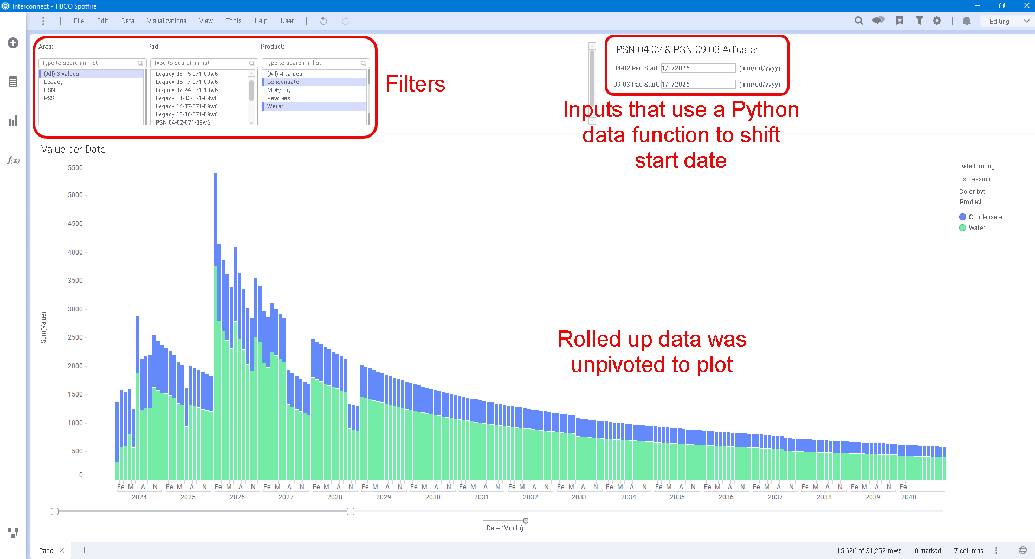
Spotfire Dashboard

